Slide 1
TER 6223
Enterprise Resource Planning
Name | ID | Programme
Darren Liew Han Jie | 1211110265 | BIA
Teh Wei Yun | 1211112194 | BIA
Shiu Li Jie | 1221308558 | BIA
Ng Xin Hui | 1211107981 | BIA
Project: ERP Implementation Proposal for Madam Yan Bukit Beruang Food Court

Slide 2
Learning Reflection
Key Learnings from the Project
Understood ERP's role in integrating business functions (e.g., HR, finance, inventory).
Realized importance of system integration for efficiency and decision-making.
Challenges: Gathering data from busy stall owners; Learning SAP modules required extra research.
Skills Gained: Teamwork, analysis, report writing, professional communication.
Future Value: Enhanced confidence in business management and IT solutions.

Slide 3
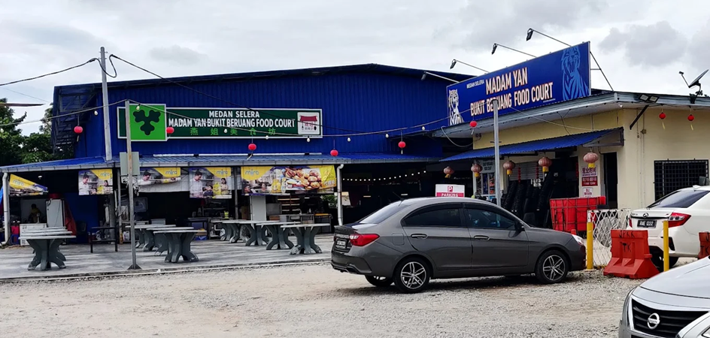
Introduction to the Business
Madam Yan Bukit Beruang Food Court Overview
Location: LOT 4427, Jalan Delima 12, Taman Bukit Melaka, Bukit Beruang, 75450 Melaka.
Operations: Open daily 11am-12am; ~25 stalls offering diverse cuisines (Chinese, Indian, Western, etc.).
Management: Central team handles maintenance, rentals; Stalls independent.
Unique Features: Near residences/schools; Promotions (e.g., student discounts); Basic facilities (seating, restrooms, parking).
Opportunities: Manual processes ripe for ERP modernization.

Slide 4
Current Business Processes
Overview of Daily Operations
Opening & Preparation: Stall setup, common area cleaning.
Inventory & Procurement: Decentralized purchasing via calls/texts; Manual tracking.
Customer Ordering & Payment: Per-stall queues; Cash/e-wallet; No central tracking.
Cleaning & Maintenance: Ongoing shared tasks; Reactive fixes.
Financial Management: Manual sales records; Monthly fee collection.

Slide 5

Challenges and Inefficiencies
Key Operational Issues
Fragmented Operations: Inconsistent stall processes; Lack of integration.
Weak Sales Visibility: Manual cash reporting; No real-time data.
Inventory Inefficiencies: Guesswork-based procurement; Waste/stock-outs.
Service Bottlenecks: Queue congestion during peaks; Order errors.
Shared-Area Issues: Reactive maintenance; Overflowing waste.

Slide 6
Relevant SAP ERP Modules
Proposed SAP Modules & Rationale
Module | Target Challenge | Key Solutions
SD (Sales & Distribution) | Fragmented orders, queues | Centralized POS/QR ordering; Dynamic promotions.
MM (Materials Management) | Inventory waste, procurement | Reorder planning; Vendor aggregation; Waste tracking.
FI (Financial Accounting) | Sales visibility, errors | Real-time revenue; Profitability analysis.
PM (Plant Maintenance) | Maintenance issues | Preventive schedules; Hygiene tasks.
HCM (Human Capital Management) | Staffing inefficiencies | Shift planning; Training management.

Slide 7
ERP Implementation Plan
Phased Deployment Approach
Preparation & Planning: Form team, define scope, collect data.
Configuration & Migration: Set up modules, migrate data.
Testing & Training: Unit/integration tests; Hands-on user training; Pilot on select stalls.
Go-Live: Deploy during low-traffic; On-site support.
Post-Support: Audits, feedback, updates.

Slide 8

Expected Benefits
Operational & Financial Gains
Operational: Faster service, reduced errors, better inventory control.
Financial: Real-time tracking, cost savings via bulk procurement.
Environmental/Social: Less waste, improved hygiene; Paperless processes.

Slide 9

SDG Impact
Supporting UN Sustainable Development Goals
SDG | Description | ERP Contribution
2 | Zero Hunger | Reduce food waste via inventory.
3 | Good Health | Enhance hygiene/food safety.
8 | Decent Work | Improve payroll/staff welfare.
9 | Innovation | Digital transformation.
12 | Responsible Production | Efficient resource use.

Slide 10
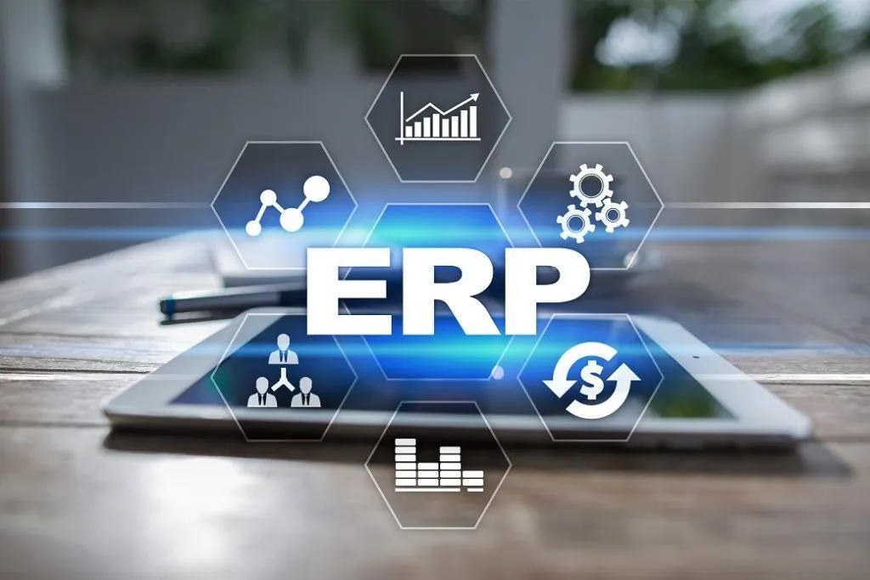
Conclusion
ERP will transform manual processes into integrated, efficient operations.
Benefits: Efficiency, cost savings, sustainability.
Call to Action: Approve implementation; Schedule pilot.

Slide 11
THANK YOU

